Slide 1
The development of CM diagnostics for prescribed actions using a combination of artificial intelligence, machine learning algorithms and a modified approach to FMECA
Experience to date
Daniel C Shorten
BiNDT CM Conference 2021 [Online]

Slide 2
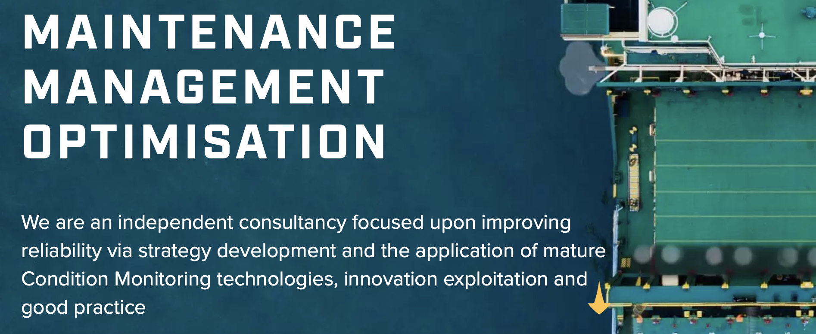
Optimain Ltd
We are an independent consultancy focused upon improving reliability via strategy development and the application of mature Condition Monitoring technologies, innovation exploitation and good practice
Find us at www.optimain.co.uk or email dcs@Optimain.co.uk

Slide 3
DiMOS Project
Innovate UK is part of UK Research and Innovation, a non-departmental public body funded by a grant-in-aid from the UK government.
The DiMOS project proposes a prescriptive maintenance digital platform for condition monitoring and maintenance planning of ship’s structure, engine machinery and auxiliary system by real-time sensor data and AI-based models to prescribe maintenance based on monitored condition and taking into account risk level, maintenance timing and associated cost.
Project Goals
Integrate ship monitoring and maintenance systems into a single platform to avoid multiple fragmented on-board maintenance systems.
Provide a prescriptive diagnostic approach in addition to the standard predictive condition monitoring approach.
Optimise the manual interpretation of data to reduce false positives and unnecessary expenditure.
Brunel University London | CMServices Global Ltd | TWI | Vibtek

Slide 4
Protected Input Streams Data Flow
Input Data
Machinery Data
Failure Modes Data
Additional Data
Events
Physical
OEM defined
RPN
CM
Contextual
Installation Specific
Contextual
Process
Operational
Location Specific
Operational
Data Ingestion
Data Processing
Feature Extraction
Diagnostic Options
Machine Learning 1
Prescribed Output
Machine Learning 2
Fault Detection
CM data can be from any source VA/LA/AE/UT/TA plus process parameters
Acquire – Assess – Prescribe - Review

Slide 5
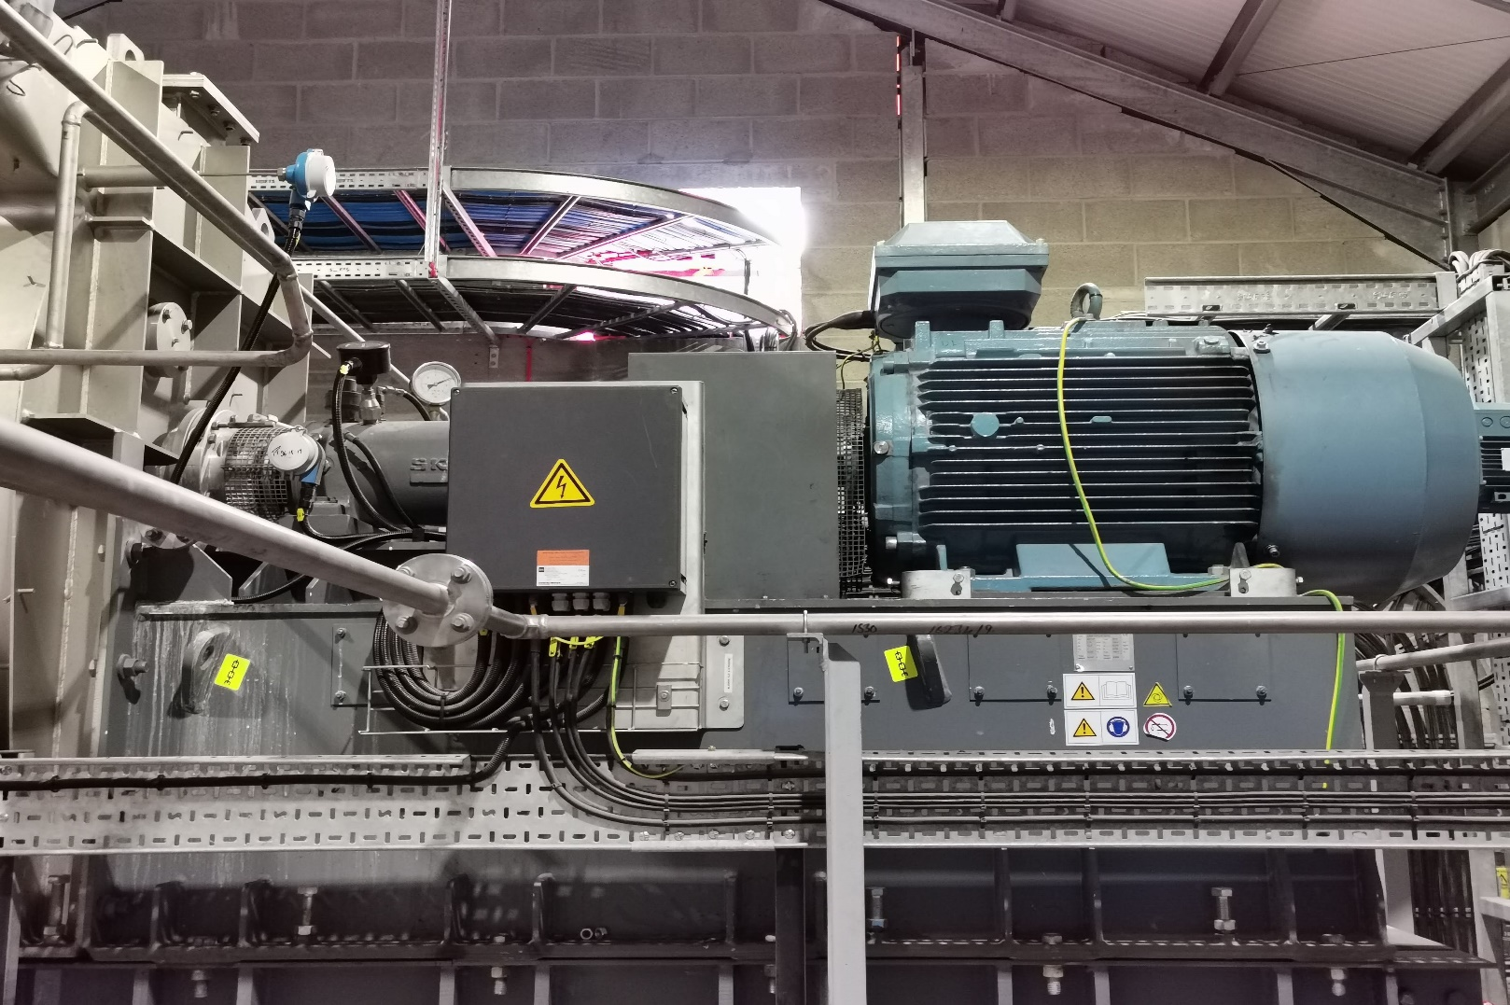
Data Acquisition example
Criticality Context
“Three in-series MVR Fan system recompress vacuum steam from approximately 280-300 mbara at 69℃ to circa 650 mbara, with a corresponding temperature of 88℃ and provide a significant portion of the 6Apps Mash Columns energy input. They are critical to maintain distillate flows of the required magnitude to meet production targets. It is possible to operate the column with the MVR system switched off but, the rate of spirit production from 6Apps would be significantly reduced.”
Asset Name | Sub-asset | Sensors | Index
MVR FAN2 | Electric motor 1 - 2 | Ax-2, RH-4,RV-4 | 1-10
 | Fan 1 - 3 | Ax-4 ,RH-4,RV-4 | 11-22
 | Fan 1 - 4 | Ax-4, RH-4,RV-4 | 23-34
MVR FAN3 | Electric motor 1 - 1 | Ax-4, RH-4,RV-4 | 35-46
 | Electric motor 1 - 2 | Ax-4, RH-4,RV-4 | 47-58
 | Fan 1 - 3 | Ax-4, RH-4,RV-4 | 59-70
 | Fan 1 - 4 | Ax-4,RH-4,RV-4 | 71-82
 |  | Total = 82 signals
Primary CM data sets are sourced from hard wired VA and process data coupled to Acoem data portal and 4g card and accessed remotely/automatically.

Slide 6
Data Flow
Data ingestion and preprocessing to check veracity and consistency
Real time data
Data pre-processing
Feature extraction
Machine Learning
Decision Making
Failure mode and criticality assessment
Diagnostics
Prescribed Action
CM data compared to known fault types
Assessment and refinement – fault / no fault
Assessment and refinement
Modified FMEAC initialized during set up then refined
PM job cards

Slide 7
Failure Modes Effects & Criticality Assessment
FMECA is well known but considered costly
FMECA can be broken down to make it more easily done
At factory gate – Failure modes which are universal – FM1
At application level – Failure modes pertinent to asset function – FM1.1
At contextual level – Failure modes specific to asset location and function – FM1.1.1
We build both FM1 and FM1.1 into the system and apply edits for FM1.1.1 at site survey – makes FMECA build significantly quicker
Whilst less robust than formal FMECA this allows us to develop learning at an accelerated pace.

Slide 8
Example FMECA Extract
FMECA | Machinery Type | Machinery Type | Failure Effect | Cnsquence (C) | Failure Mode | Cause | Cause 2 | Root Cause | Mitigation | Detection Method | Liklihood (L) | Detectability (D) | RPN (C x L x D)
Piller Radial Fan | MVR Fan | Electric motor | Fan inoperable | 7 | Bearing seizure | Bearing Failure | Poor lubrication | Grease dry | Training and documentation | VA | 6 | 6 | 252
Piller Radial Fan | MVR Fan | Electric motor | Fan inoperable | 10 | Reduced lifespan | Insulation and winding breakdown | Thermal deterioration - All phase failure | Excessive load demand | Renew | Routine resistance testing | 4 | 6 | 240
Piller Radial Fan | MVR Fan | Electric motor | Fan inoperable | 10 | Serious injury | Switchgear faillure | Vibration | Overstressed switchgear | Renew | Routine visual inspection | 4 | 6 | 240
Piller Radial Fan | MVR Fan | Electric motor | Fan inoperable | 9 | Reduced lifespan | Insulation and winding breakdown | Thermal deterioration - Single phase failure | Unequal voltage | Renew | Routine resistance testing | 4 | 6 | 216
Piller Radial Fan | MVR Fan | Electric motor | Fan inoperable | 10 | Serious motor damage | Stator damage | Variation in air gap | Mechnical stress | Perform balance check | VA | 3 | 6 | 180
Piller Radial Fan | MVR Fan | Electric motor | Fan inoperable | 10 | Serious motor damage | Stator damage | Loose Iron (weakness/looseness of stator support) | Poor installation | Renew | VA | 3 | 6 | 180
Piller Radial Fan | MVR Fan | Electric motor | Fan inoperable | 10 | Electrical fire | Electrical Connections | Overheating | Looseness | Renew | Monthly visual inspection | 3 | 6 | 180
Piller Radial Fan | MVR Fan | Electric motor | Fan inoperable | 7 | Bearing seizure | Bearing Failure | Poor lubrication | Abrasion | Routine visual inspection | VA | 4 | 6 | 168
Piller Radial Fan | MVR Fan | Electric motor | Fan inoperable | 10 | Bearing failure | Excessive Noise | Coupling misaligned | Defective seals | Renew | VA | 4 | 4 | 160
Piller Radial Fan | MVR Fan | Electric motor | Fan inoperable | 8 | Bearing seizure | Bearing Failure | Poor lubrication | Wrong grease used | Follow Manufacturers instructions | Record grease usage act accordingly | 3 | 6 | 144
Piller Radial Fan | MVR Fan | Electric motor | Fan inoperable | 8 | Bearing seizure | Bearing Failure | Poor lubrication | Insufficient Lubrication | Follow Manufacturers instructions | Record grease usage act accordingly | 3 | 6 | 144
Piller Radial Fan | MVR Fan | Electric motor | Fan inoperable | 8 | Bearing seizure | Bearing Failure | Poor lubrication | Water | Routine visual inspection | Water content test | 4 | 4 | 128
Piller Radial Fan | MVR Fan | Electric motor | Fan inoperable | 8 | Imbalance | Rotor damage | Rotor bent | Mechnical stress | Renew | VA | 4 | 4 | 128
Piller Radial Fan | MVR Fan | Electric motor | Fan inoperable | 8 | Imbalance | Rotor damage | Rotor bent | Heat Stress | Renew | VA | 4 | 4 | 128
Piller Radial Fan | MVR Fan | Electric motor | Fan inoperable | 8 | Imbalance | Broken Rotor bars | Stress | Heat stress | Renew | VA | 4 | 4 | 128
Piller Radial Fan | MVR Fan | Electric motor | Fan inoperable | 8 | Bearing failure | Cooling Fan failure | Imbalance | Corrosion | Renew fan | VA | 4 | 4 | 128
Piller Radial Fan | MVR Fan | Electric motor | Fan inoperable | 8 | Bearing failure | Cooling Fan failure | Imbalance | Physical damage | Renew fan | VA | 4 | 4 | 128
Piller Radial Fan | MVR Fan | Electric motor | Fan inoperable | 8 | Bearing failure | Cooling Fan failure | Imbalance | Dirt build up | Clean and rebalance | VA | 4 | 4 | 128
Piller Radial Fan | MVR Fan | Electric motor | Fan inoperable | 10 | Serious motor damage | Stator damage | Shorted lamination | deterioration of winding insulations | Fit mechanical or electrical shunts | Routine resistance testing | 3 | 4 | 120
Piller Radial Fan | MVR Fan | Electric motor | Fan inoperable | 9 | Reduced lifespan | Insulation and winding breakdown | Overheating | Shorting | Reduce excessive load | Routine resistance testing | 3 | 4 | 108
Piller Radial Fan | MVR Fan | Electric motor | Fan inoperable | 9 | Reduced lifespan | Insulation and winding breakdown | Overheating | Dirt build up | Routine cleaning | Routine resistance testing | 3 | 4 | 108
Piller Radial Fan | MVR Fan | Electric motor | Fan inoperable | 9 | Motor damage | Physical Connection damage | Vibration | Looseness | Renew | VA | 3 | 4 | 108
Piller Radial Fan | MVR Fan | Electric motor | Fan inoperable | 7 | Bearing seizure | Bearing Failure | Vibration | Misalignment | Routine visual inspection | VA | 3 | 4 | 84
Piller Radial Fan | MVR Fan | Electric motor | Fan inoperable | 7 | Bearing seizure | Bearing Failure | Vibration | Overheating | Routine visual inspection | VA | 3 | 4 | 84
Piller Radial Fan | MVR Fan | Electric motor | Fan inoperable | 5 | Bearing seizure | Bearing Failure | Electrical discharge | Poor earthing | Assess and repair earthing straps | Visual inspection of earthing straps | 4 | 4 | 80
Piller Radial Fan | MVR Fan | Electric motor | Fan inoperable | 6 | Bearing seizure | Bearing Failure | Vibration | Soft Foot | Routine visual inspection | VA | 3 | 4 | 72
Piller Radial Fan | MVR Fan | Electric motor | Fan inoperable | 6 | Bearing seizure | Bearing Failure | Vibration | Imbalance | Routine visual inspection | VA | 3 | 4 | 72
Piller Radial Fan | MVR Fan | Electric motor | Fan inoperable | 5 | Bearing seizure | Bearing Failure | Fatigue | Transient vibration | Assess and repair. Isolate bearings | VA | 3 | 4 | 60
Piller Radial Fan | MVR Fan | Electric motor | Fan inoperable | 5 | Bearing seizure | Fan auto control defective | Fatigue | Frequent stop/starts | Check control settings. Renew if required | Adjust settings | 5 | 2 | 50

Slide 9
Fault Detection Structure
Proposed fault detection structure using Auto Encoder and Mahalanobis distance on a system level and component level
The Auto Encoder is the key part of the fault detection model, as it reconstructs monitoring data using training data.
Mahalanobis distance is employed to measure the distance between the true monitoring data and the reconstructed data, and formed into one health indicator.

Slide 10
Simplified Novelty detection
Novelty detection with a one-class SVM model:
Train the model on healthy machine data.
Define a frontier/boundary for ‘normal’ observations.
Each new measurement is given a score, a measure of how ‘normal’ the point is.
A positive score is normal and within the boundary.
Negative is abnormal – indicative of a change in the operation of the machine or a developing fault.

Slide 11
Risk assessment using condition monitoring data

Slide 12
Further development
We have sites established in UK @ Royal Mail, Grants Distillery and Toyota
We are exploring the addition of lube analysis and oil sensor data to the VA set-ups
Software support for trusted outputs
We are working on the basis that for machinery protection and additional assurance, that “just enough, is good enough”

Slide 13
Conclusions
Quick and easy FMECA
Gains quick start maturity
Core intelligence grows
Providing better diagnostics and useful ongoing reliability data

